Slide 1
Weekly meeting 2
Shengya Guo, CR/AVS3, 21.06.2024

Slide 2
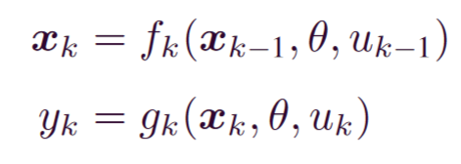

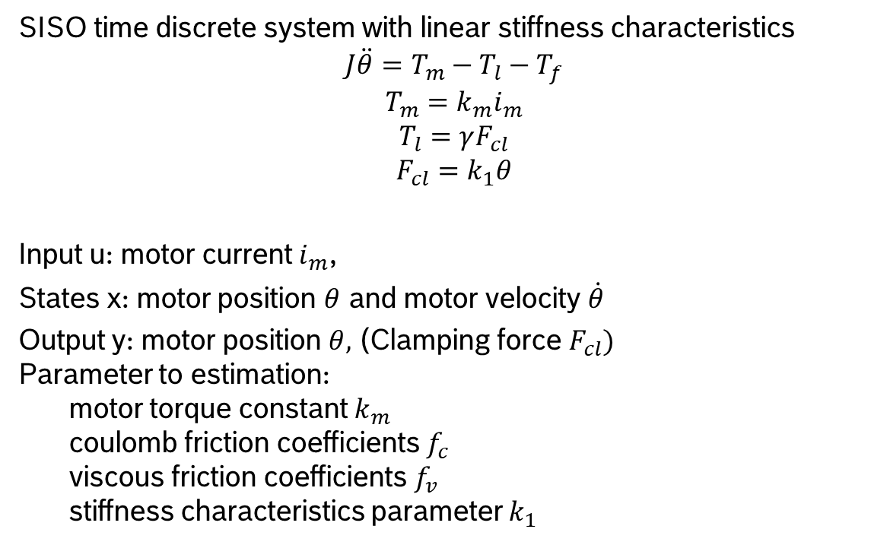
Introduction of the simplified EMB model
SISO time discrete system with linear stiffness characteristics
$$J\ddot{θ}=T_{m}−T_{l}−T_{f}$$
$$T_{m}=k_{m}i_{m}$$
$$T_{l}=γF_{cl}$$
$$F_{cl}=k_{1}θ$$
Input u: motor current $i_{m}$,
States x: motor position $θ$ and motor velocity $\dot{θ}$
Output y: motor position $θ,$ (Clamping force $F_{cl})$
Parameter to estimation:
motor torque constant $k_{m}$
coulomb friction coefficients $f_{c}$
viscous friction coefficients$f_{v}$
stiffness characteristics parameter $k_{1}$

Slide 3
Working Plan
work
Research of the state of the art
Implement a simple EMB model in Gym
Stage I
Set up RL Framework and train the Agent
Implement realistic EMB model in Gym
Stage II
Train the RL Agent
Train and test RL in the real world
(only when good result in simulation finded)
Stage III
Writing Thesis
June
July
August
September
October
November
December
time

Slide 4
Now
Simplified EMB model was built in Python with the conventional parameter from Lauble

Slide 5
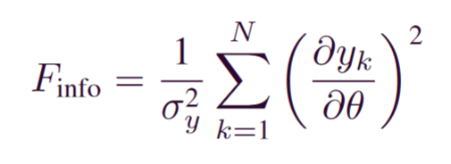
Next step
Research about Cramer-Rao bound and Fischer Information
Build up the gym environment for the parameter estimation of EMB

